Slide 1
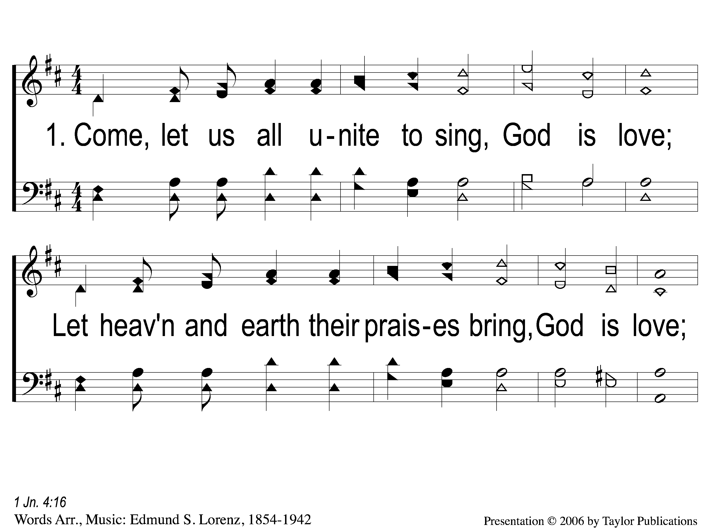
1-1 Come, Let Us All Unite to Sing
Come, Let Us All Unite to Sing
72

Slide 2
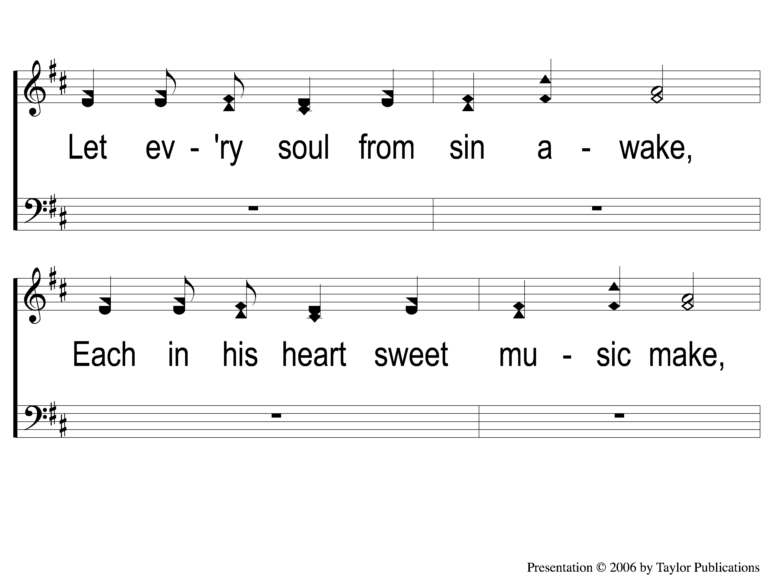
1-2 Come, Let Us All Unite to Sing
Come, Let Us All Unite to Sing
72

Slide 3
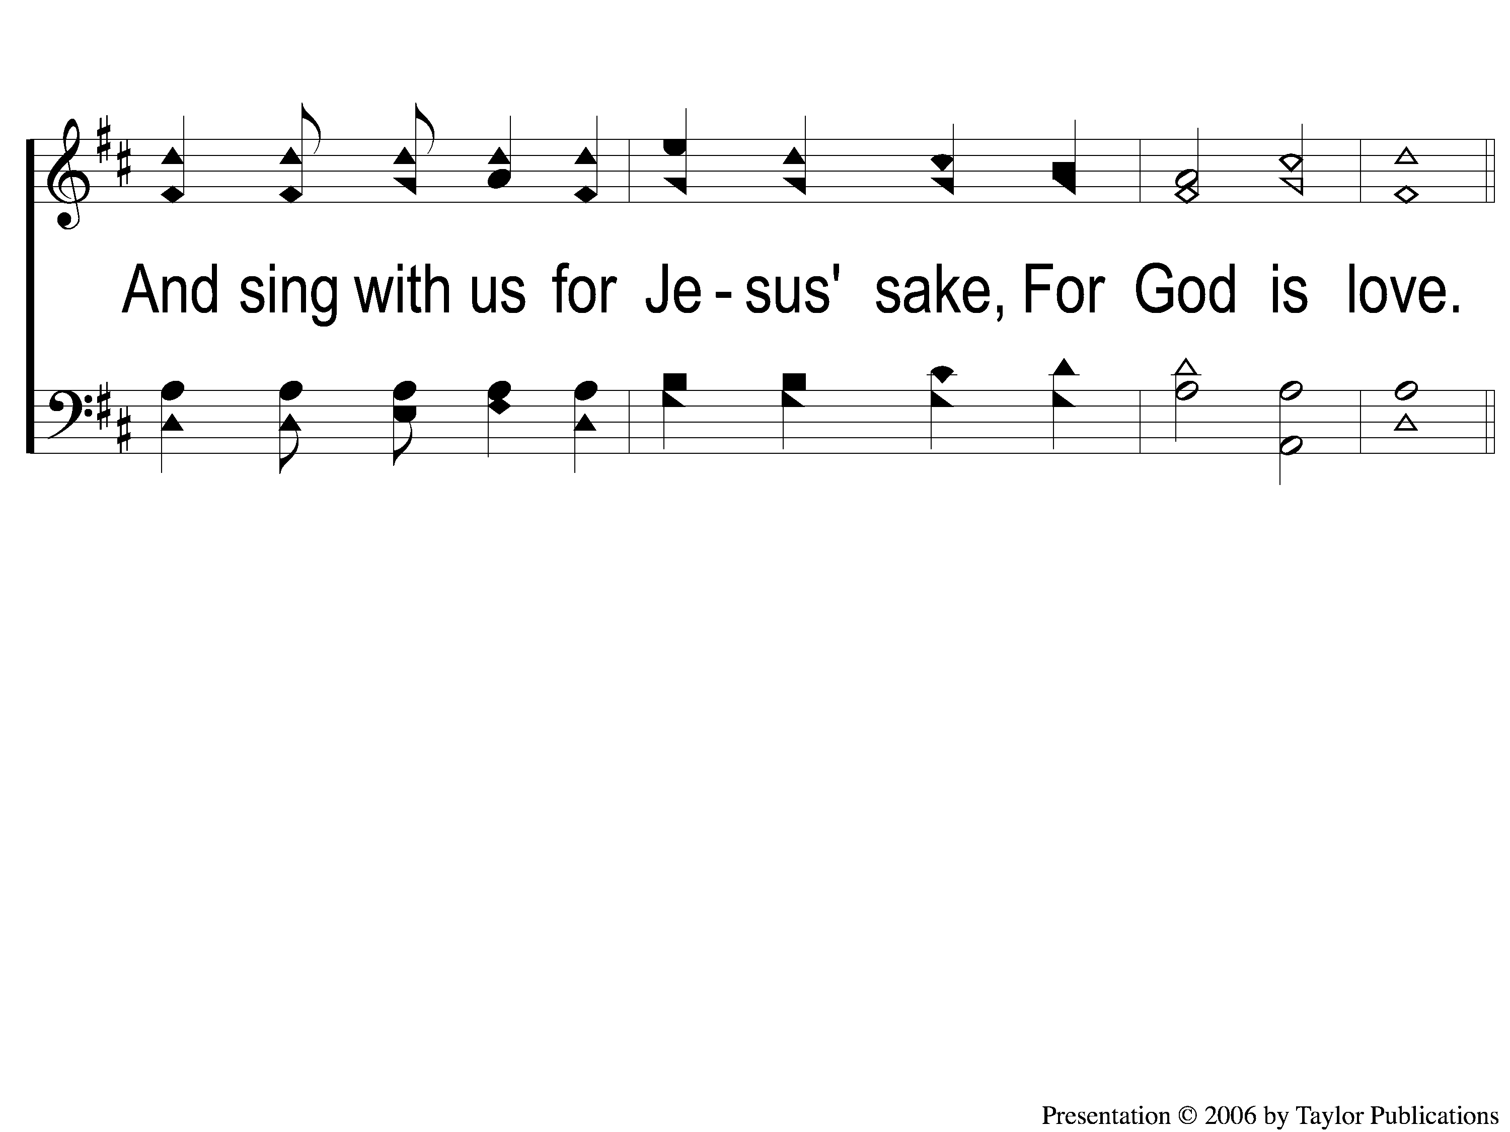
1-3 Come, Let Us All Unite to Sing
Come, Let Us All Unite to Sing
72

Slide 4
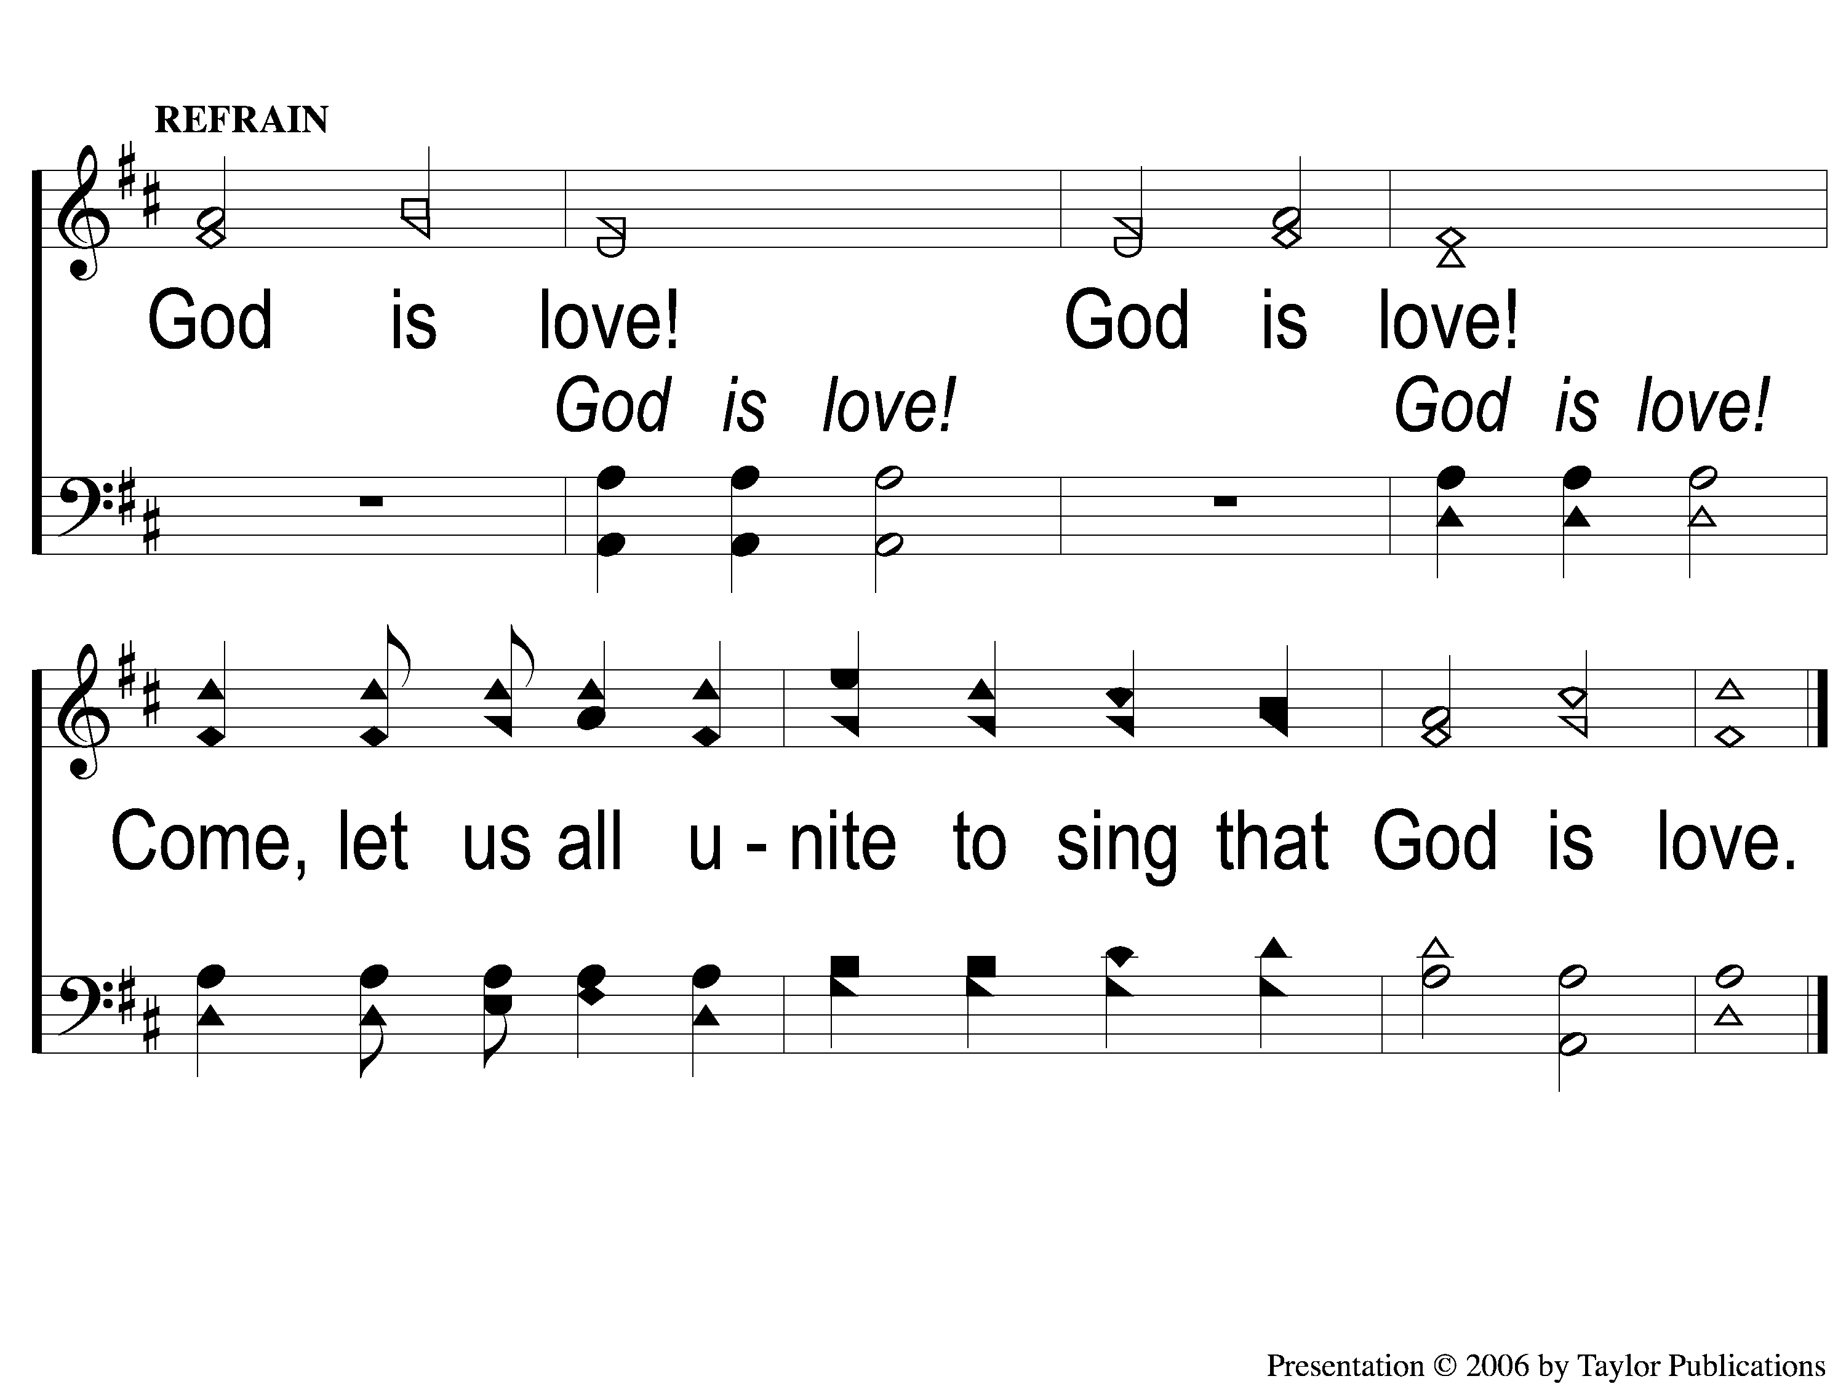
C Come, Let Us All Unite to Sing
Come, Let Us All Unite to Sing
72

Slide 5
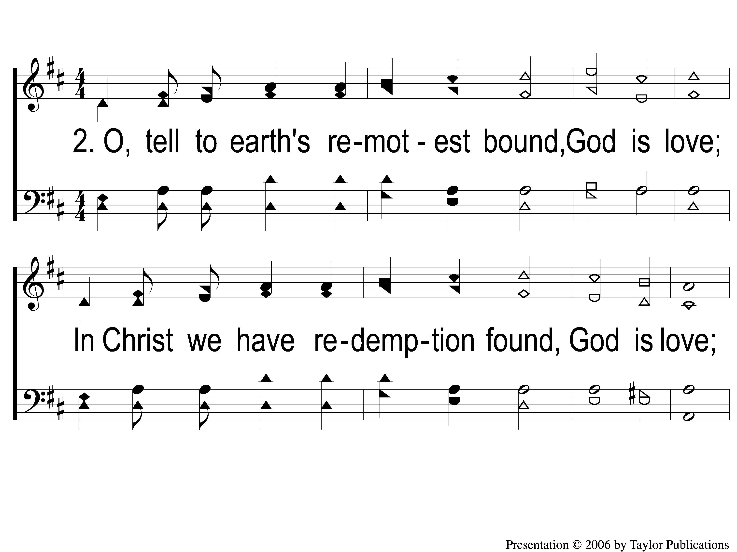
2-1 Come, Let Us All Unite to Sing
Come, Let Us All Unite to Sing
72

Slide 6
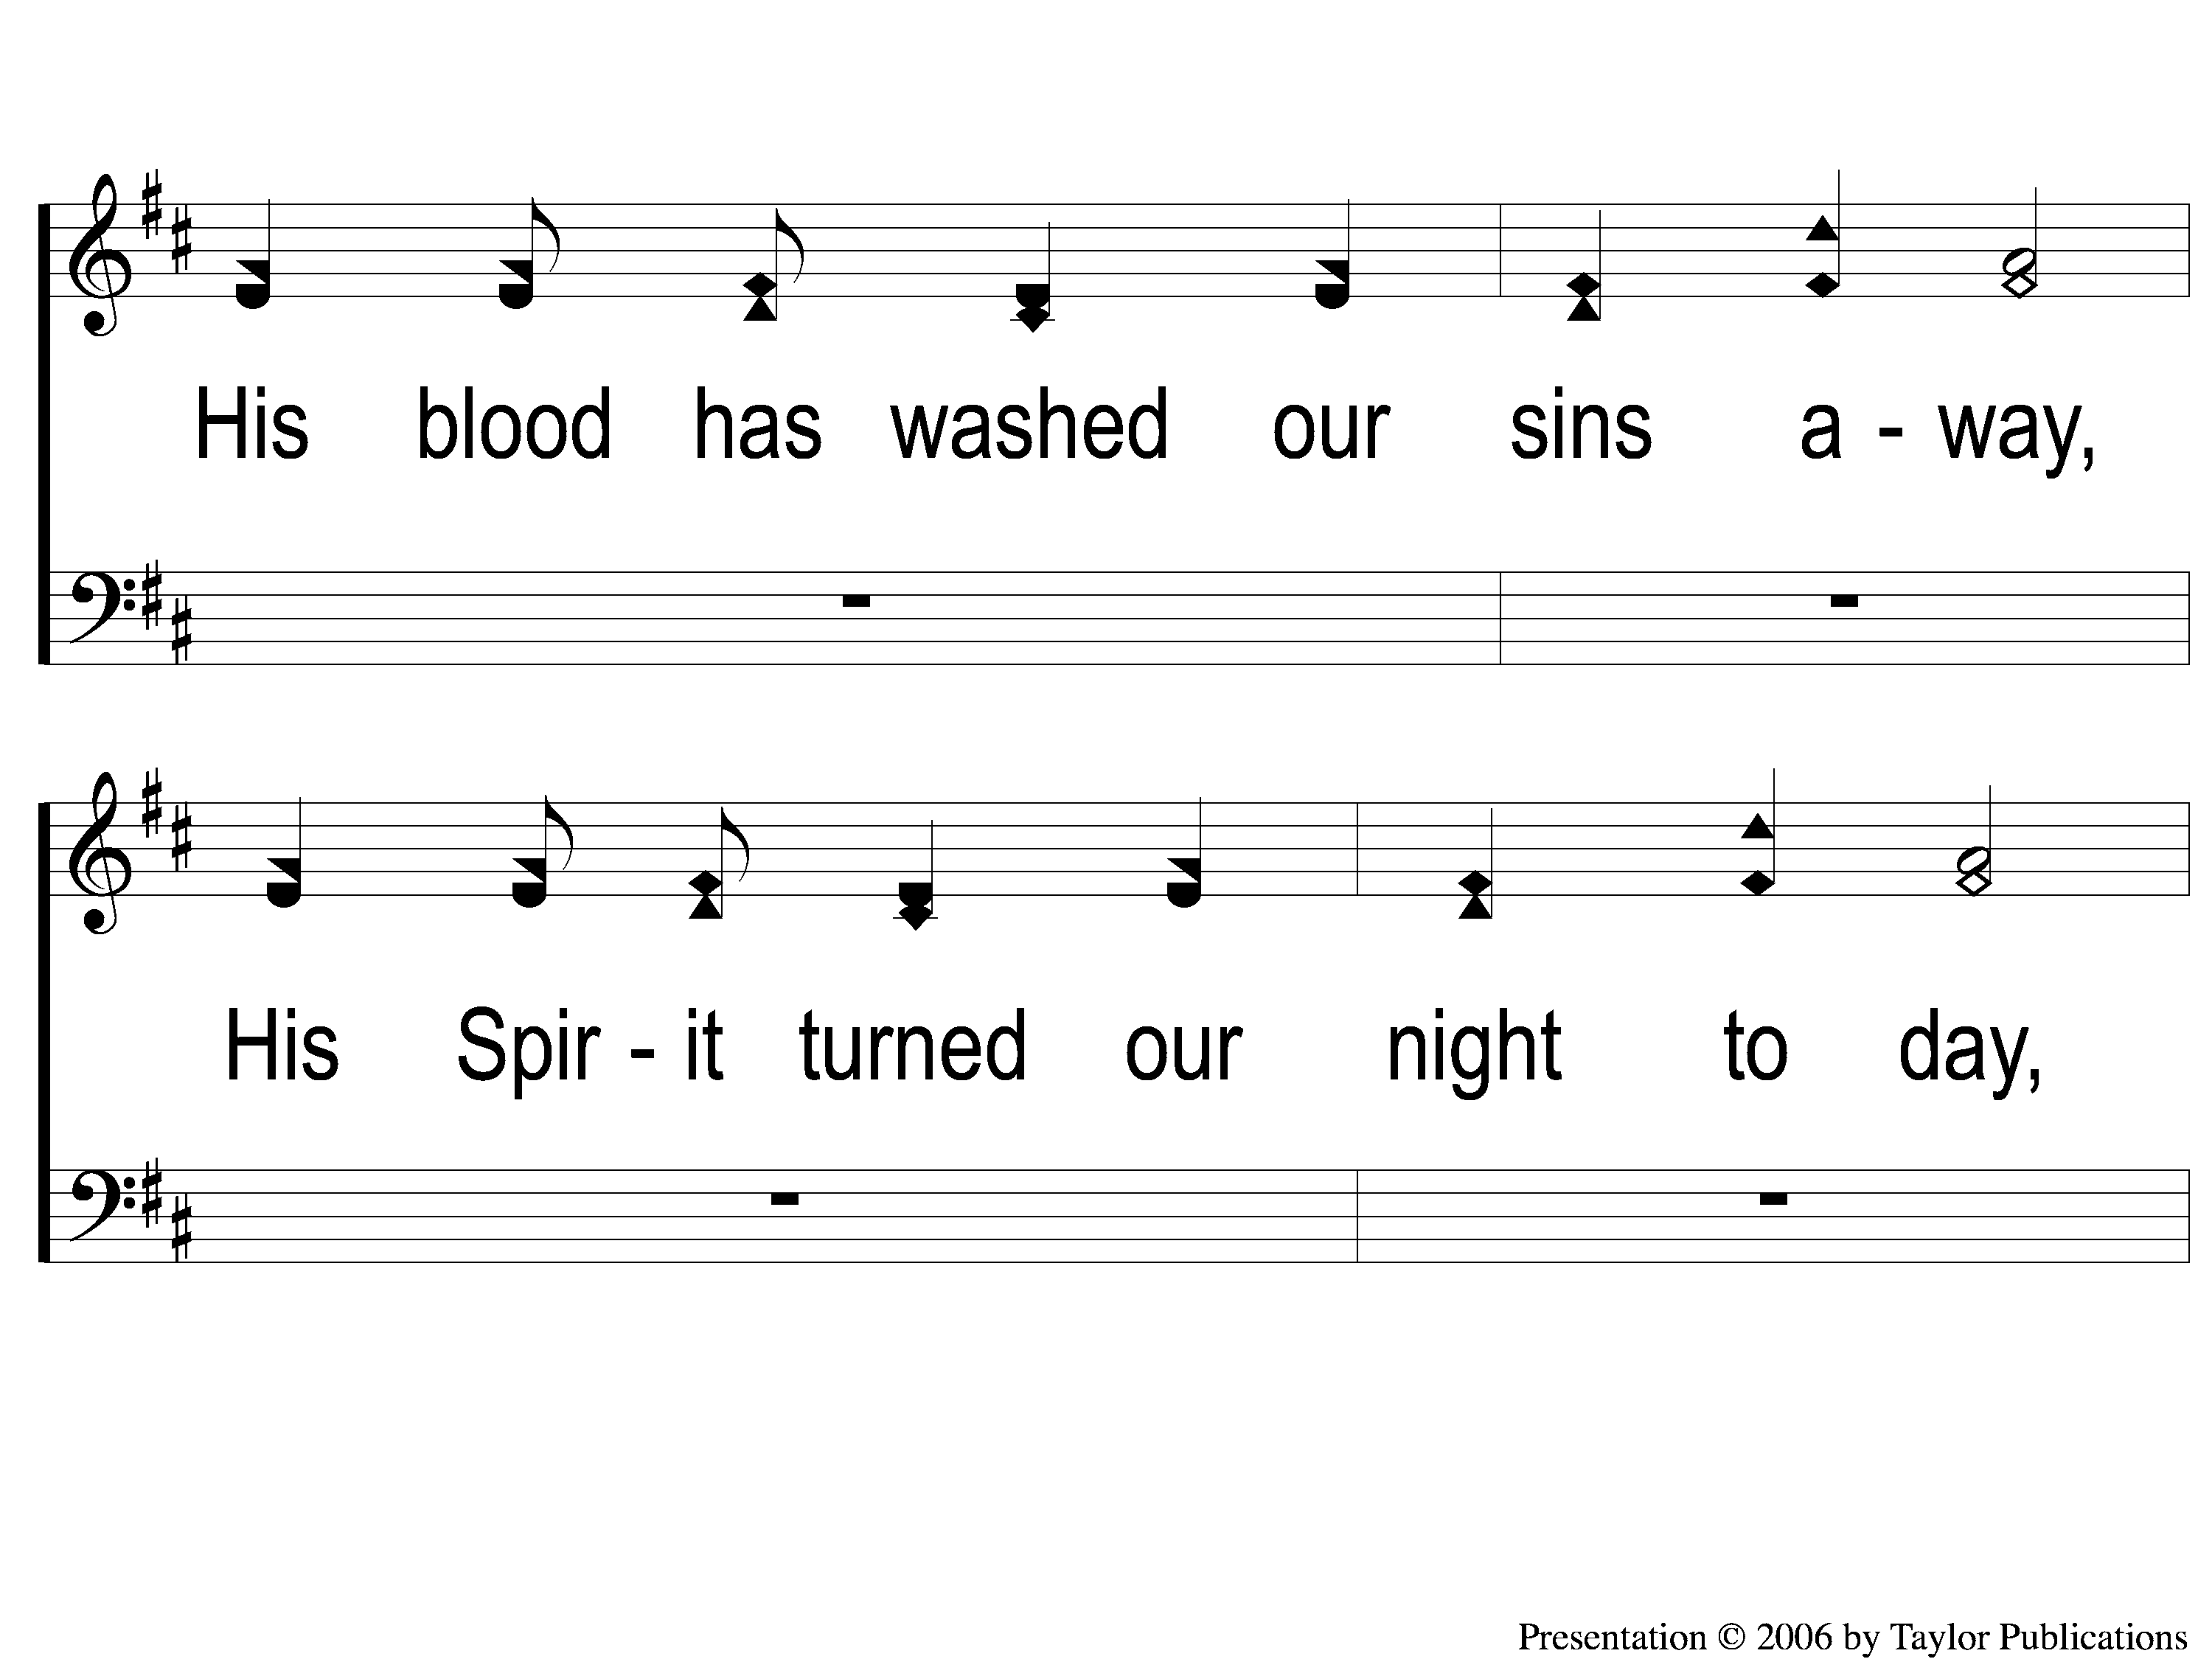
2-2 Come, Let Us All Unite to Sing
Come, Let Us All Unite to Sing
72

Slide 7
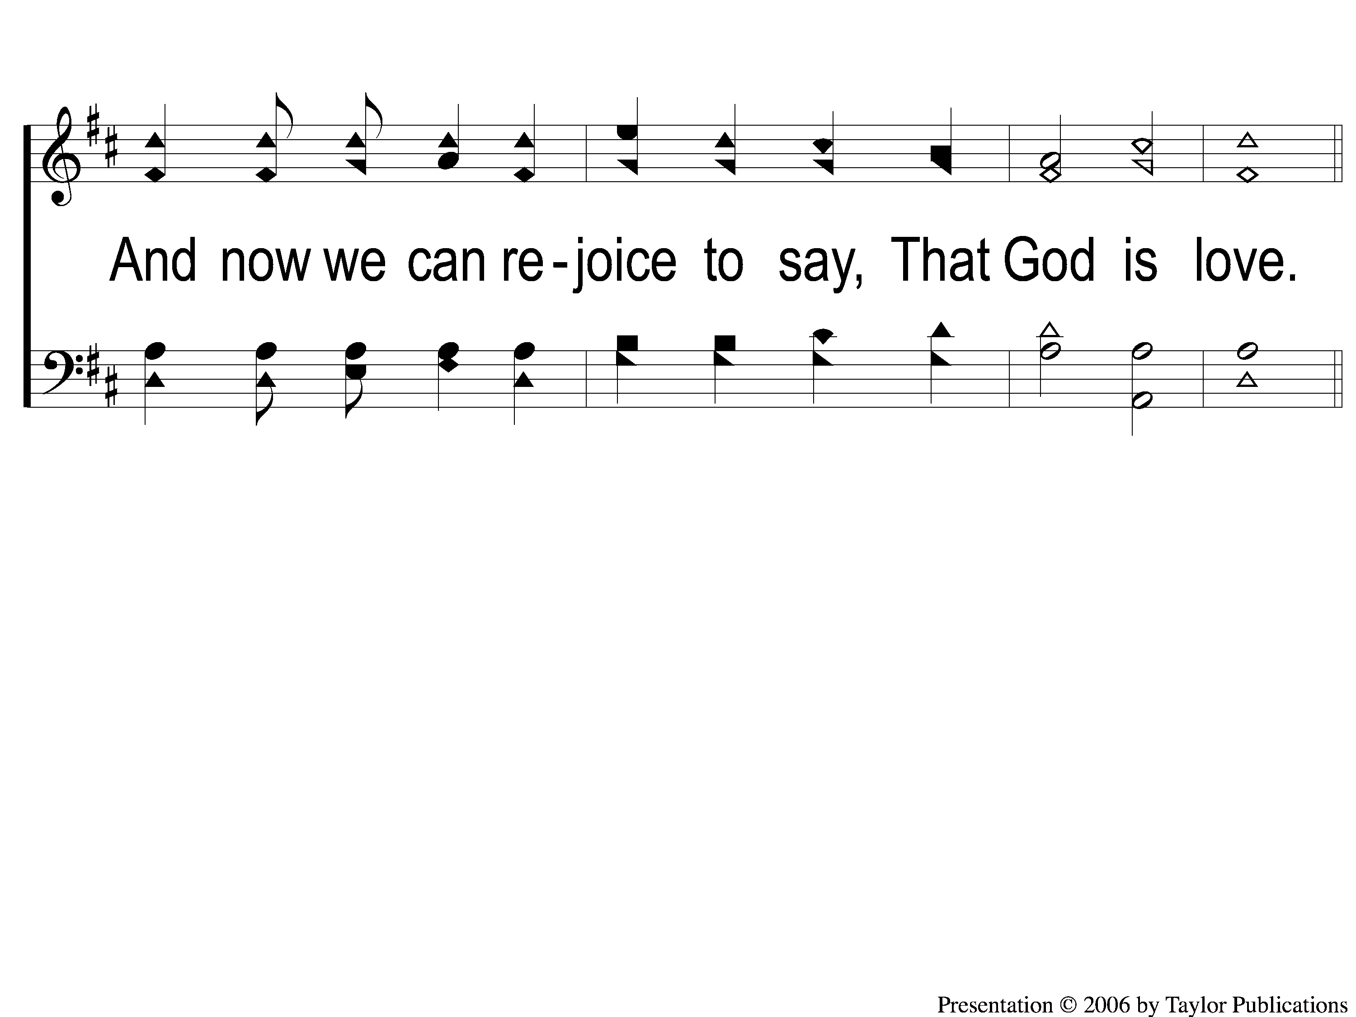
2-3 Come, Let Us All Unite to Sing
Come, Let Us All Unite to Sing
72

Slide 8
C Come, Let Us All Unite to Sing
Come, Let Us All Unite to Sing
72

Slide 9
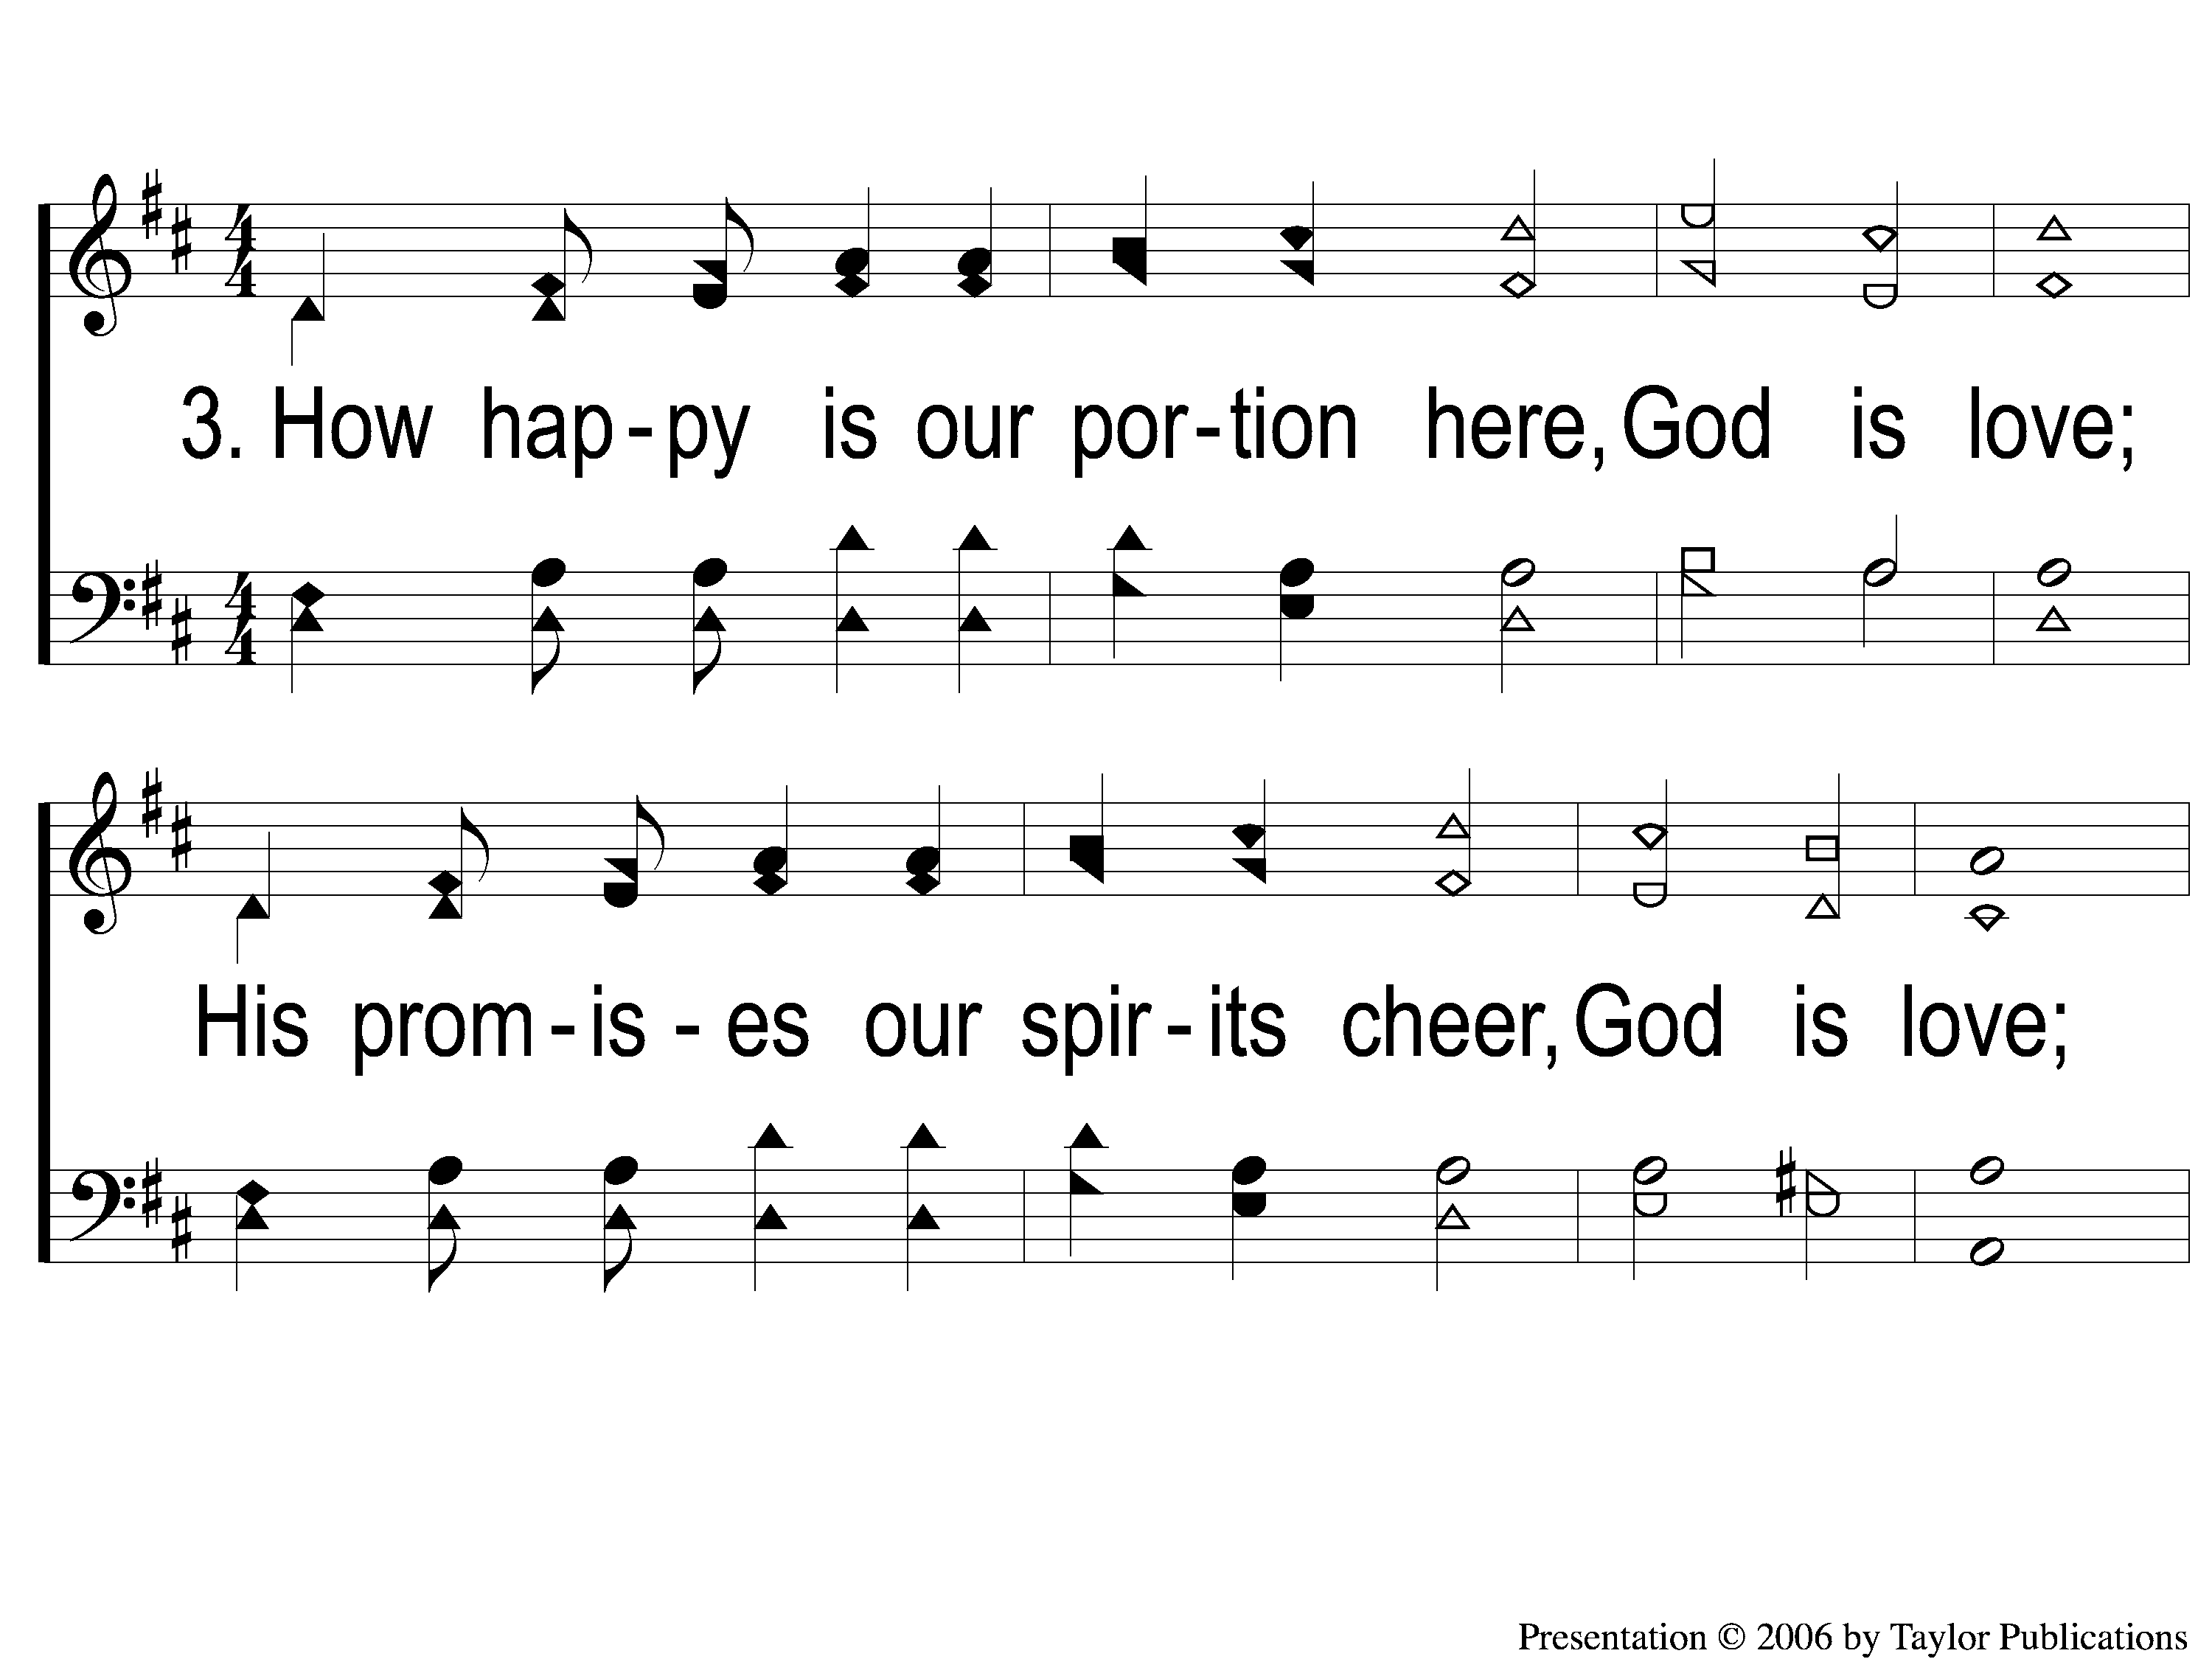
3-1 Come, Let Us All Unite to Sing
Come, Let Us All Unite to Sing
72

Slide 10
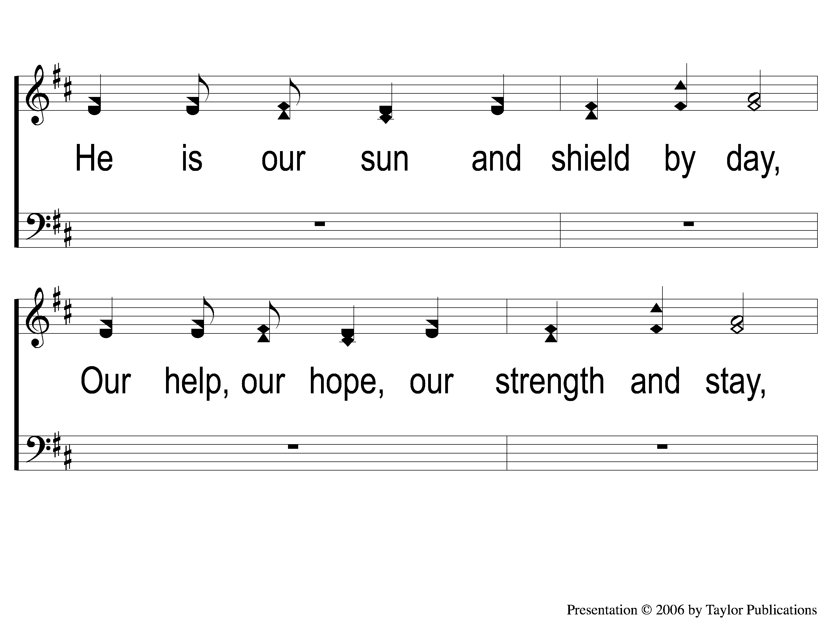
3-2 Come, Let Us All Unite to Sing
Come, Let Us All Unite to Sing
72

Slide 11
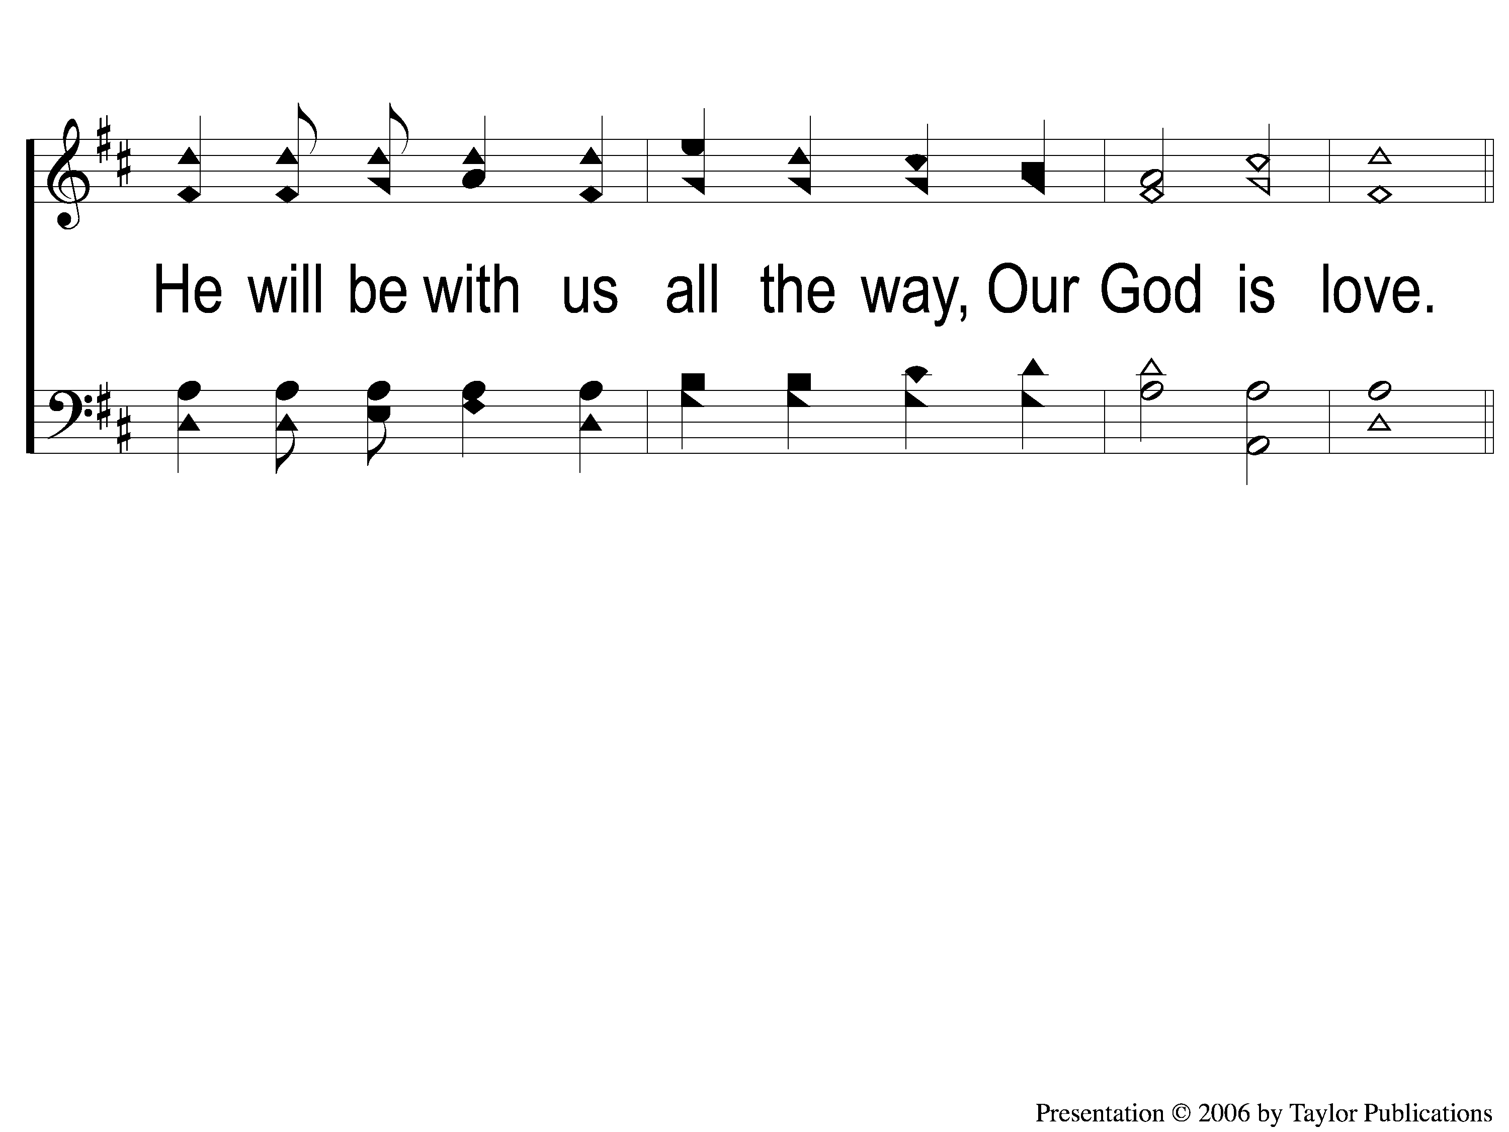
3-3 Come, Let Us All Unite to Sing
Come, Let Us All Unite to Sing
72

Slide 12
C Come, Let Us All Unite to Sing
Come, Let Us All Unite to Sing
72

Slide 13
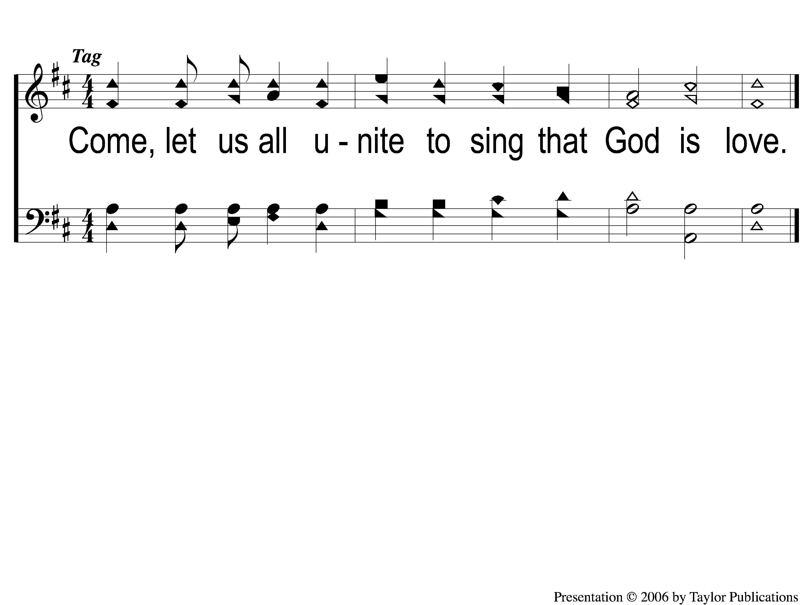
Opt tag Come, Let Us All Unite to Sing
Come, Let Us All Unite to Sing
72

